Slide 1
File Management in C
Aum Sri Sai Ram

Slide 2
Types of Input-Output (I/O)
There are 3 types of I/O:
  Console I/O
  String I/O
  File I/O

Slide 3
Console oriented Input/Output
Console oriented – use terminal (keyboard/screen)
scanf(“%d”,&i) – read data from keyboard
printf(“%d”,i) – print data to monitor
Suitable for small volumes of data
Data lost when program terminated
Formatted/ Un-formatted

Slide 4
Real-life applications
Large data volumes
E.g. physical experiments in lab, human genome, population records etc.
Need for flexible approach to store/retrieve data
Concept of files

Slide 5
What is a File?
A file is a collection of related data that a computers treats as a single unit.
Computers store files to secondary storage so that the contents of files remain intact when a computer shuts down.
When a computer reads a file, it copies the file from the storage device to memory; when it writes to a file, it transfers data from memory to the storage device.
C uses a structure called FILE (defined in stdio.h) to store the attributes of a file.

Slide 6
Filename
String of characters that make up a valid filename for OS
May contain two parts
  Primary
  Optional period with extension
Examples: a.out, prog.c, temp, text.out

Slide 7
Steps in Processing a File
Create the stream via a pointer variable using the FILE structure:
FILE *fp;
Open the file, associating the stream name with the file name.
Read or write the data.
Close the file.

Slide 8
Defining and opening file
To store data file in secondary memory (disc) must specify to OS
  Filename (e.g. sort.c, input.data)
  Structure Pointer (e.g. FILE)
  Purpose (e.g. reading, writing, appending)

Slide 9
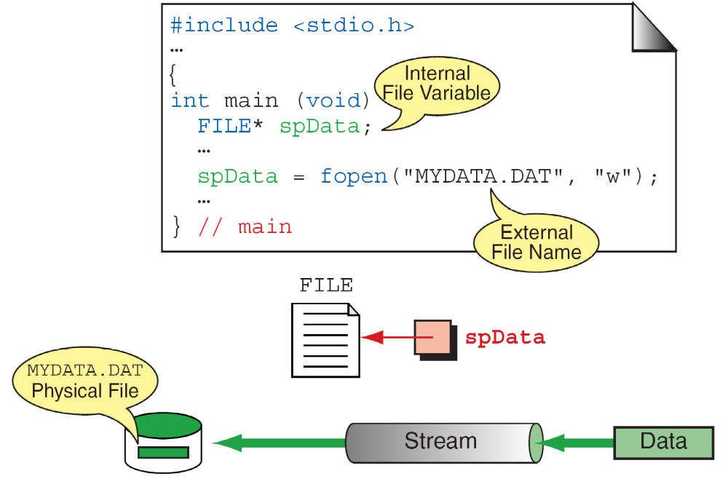
fopen

Slide 10
General format for opening file
FILE *fp; /*variable fp is pointer to type FILE*/
fp = fopen(“filename”, “mode”);
/*opens file with name filename , assigns identifier to fp */
fp
  contains all information about file
  Communication link between system and program
Mode can be
  r open file for reading only
  w open file for writing only
  a open file for appending (adding) data

Slide 11
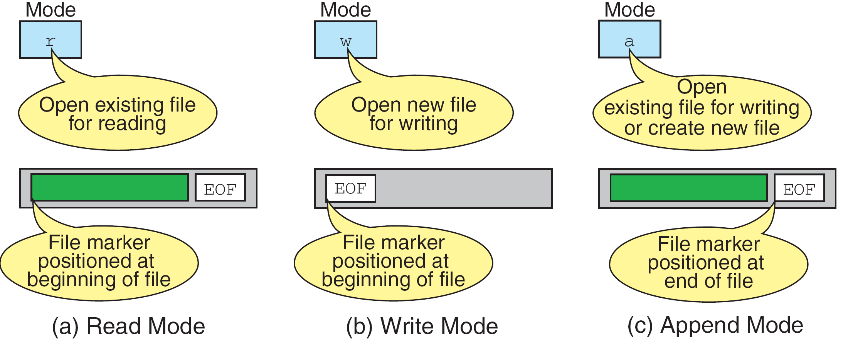
File Open Modes

Slide 12
Different modes
Writing mode
  if file already exists then contents are deleted,
  else new file with specified name created
Appending mode
  if file already exists then file opened with contents safe
  else new file created
Reading mode
  if file already exists then opened with contents safe
  else error occurs.
FILE *p1, *p2;
p1 = fopen(“data”,”r”);
p2= fopen(“results”, w”);

Slide 13
Additional modes
r+ open to beginning for both reading/writing
w+ same as w except both for reading and writing
a+ same as ‘a’ except both for reading and writing

Slide 14
Closing a file
File must be closed as soon as all operations on it completed
Ensures
  All outstanding information associated with file flushed out from buffers
  All links to file broken
  Accidental misuse of file prevented
If want to change mode of file, then first close and open again

Slide 15
Closing a file
Syntax: fclose(file_pointer);
Example:
FILE *p1, *p2;
p1 = fopen(“INPUT.txt”, “r”);
p2 =fopen(“OUTPUT.txt”, “w”);
……..
……..
fclose(p1);
fclose(p2);
pointer can be reused after closing

Slide 16
Input/Output operations on files
C provides several different functions for reading/writing
fgetc() – read a character
fputc() – write a character
fprintf() – write set of data values
fscanf() – read set of data values
fgets() – read string
fputs() – write string

Slide 17
fgetc() and fputc()
handle one character at a time like getchar() and putchar()
syntax: fputc(c,fp1);
  c : a character variable
  fp1 : pointer to file opened with mode w
syntax: c = fgetc(fp2);
  c : a character variable
  fp2 : pointer to file opened with mode r
file pointer moves by one character position after every fgetc() and fputc()
fgetc() returns end-of-file marker EOF when file end reached

Slide 18
Program to read/write using fgetc/fputc
#include <stdio.h>
main()
{ FILE *f1;
char c;
f1= fopen(“INPUT”, “w”); /* open file for writing */
if(f1==NULL)
{
printf(“could not open file so existing.”);exit(-1);
}
while((c=getchar()) != ‘$’) /*get char from keyboard until ‘$’*/
fputc(c,f1); /*write a character to INPUT */
fclose(f1); /* close INPUT */
f1=fopen(“INPUT”, “r”); /* reopen file */
while((c=fgetc(f1))!=EOF) /*read character from file INPUT*/
printf(“%c”, c); /* print character to screen */
fclose(f1);
} /*end main */

Slide 19
Class Exercise
Write a program to count total number of
  Characters
  Tabs
  New lines
  in a file sample.txt created by you on shell prompt.
  $ touch sample.txt
  $ cat >> sample.txt
  File sample.txt should have content as follow:
  Swami, we are your children.
  Please bless us so that we always hold on
  to You.

Slide 20
Quick review
Why Files?
How C program connects to a file?
fopen, fclose
Modes
Functions for I/O
11/04/19

Slide 21
Quick Summary
File Structure
Open file
Do operation: fgetc & fputc
Close file
File modes:
r, w, a, r+, w+, a+
Qs.
If File exists what happens?---File pointer points where?
File does not exist?
Operations possible

Slide 22
Input/Output operations on files
C provides several different functions for reading/writing
fgetc() – read a character
fputc() – write a character
fprintf() – write set of data values
fscanf() – read set of data values
fgets() – read string
fputs() – write string

Slide 23
fgets() and fputs()
handle one integer at a time
syntax: fputs(s,fp1);
  s : string variable
  fp1 : pointer to file opened with mode w
syntax: fgets(s,80,fp2);
  s : an string variable
  fp2 : pointer to file opened with mode r
file pointer moves by one 80 position
fgets() returns end-of-file marker EOF when file end reached

Slide 24
fscanf() and fprintf()
similar to scanf() and printf()
in addition provide file-pointer
given the following
  file-pointer f1 (points to file opened in write mode)
  file-pointer f2 (points to file opened in read mode)
  integer variable i
  float variable f
Example:
fprintf(f1, “%d %f\n”, i, f);
fprintf(stdout, “%f \n”, f); /*note: stdout refers to screen */
fscanf(f2, “%d %f”, &i, &f);
fscanf returns EOF when end-of-file reached

Slide 25
Exercise
Write student details of your class in a file studentdetails.txt
Student details?
How to represent?
What functions to use?

Slide 26
Command line arguments
can give input to C program from command line
E.g. > a.out 10 name1 name2 ….
how to use these arguments?
    main ( int argc, char *argv[] )
argc – gives a count of number of arguments (including program name)
char *argv[] defines an array of pointers to character (or array of strings)
argv[0] – program name
argv[1] to argv[argc -1] give the other arguments as strings

Slide 27
Example args.c
#include <stdio.h>
main(int argc,char *argv[])
{
while(argc>0) /* print out all arguments in reverse order*/
{
printf("%s\n",argv[argc-1]);
argc--;
}
}
$ cc args.c -o args.out
$ ./args.out 2 join leave 6
6
leave
join
2
./args.out
$

Slide 28
Errors that occur during I/O
Typical errors that occur
  trying to read beyond end-of-file
  trying to use a file that has not been opened
  perform operation on file not permitted by ‘fopen’ mode
  open file with invalid filename
  write to write-protected file

Slide 29
Error handling
Given file-pointer, check if EOF reached, errors while handling file, problems opening file etc.
check if EOF reached: feof()
feof() takes file-pointer as input, returns nonzero if all data read and zero otherwise
if(feof(fp))
printf(“End of data\n”);
ferror() takes file-pointer as input, returns nonzero integer if error detected else returns zero
if(ferror(fp) !=0)
perror(“An error has occurred”);

Slide 30
Error while opening file
if file cannot be opened then fopen returns a NULL pointer
Good practice to check if pointer is NULL before proceeding
  fp = fopen(“input.dat”, “r”);
  if (fp == NULL)
  printf(“File could not be opened \n ”);

Slide 31
Random access to files
how to jump to a given position (byte number) in a file without reading all the previous data?
fseek (file-pointer, offset, position);
position: 0 (beginning), 1 (current), 2 (end)
offset: number of locations to move from position
  Example: fseek(fp,-m, 1); /* move back by m bytes from current position */
  fseek(fp,m,0); /* move to (m+1)th byte in file */
  fseek(fp, -10, 2); /* what is this? */
ftell(fp) returns current byte position in file
rewind(fp) resets position to start of file

Slide 32
fseek()
This function sets the file position indicator for the stream pointed to by stream or you can say it seeks a specified place within a file and modify it.
  SEEK_SET Seeks from beginning of file--------------------→0
  SEEK_CUR Seeks from current position--------------------→1
  SEEK_END Seeks from end of file--------------------→2
Example:
#include <stdio.h>
int main()
{
FILE * f;
f = fopen("myfile.txt", "w");
fputs("Hello World", f);
fseek(f, 6, SEEK_SET); // SEEK_CUR, SEEK_END
fputs(" India", f);
fclose(f);
return 0;
}

Slide 33
ftell()
offset = ftell( file pointer );
"ftell" returns the current position for input or output on the file
#include <stdio.h>
int main(void)
{
FILE *stream;
stream = fopen("MYFILE.TXT", "w");
fprintf(stream, "This is a test");
printf("The file pointer is at byte %ld\n", ftell(stream));
fclose(stream);
return 0;
}

Slide 34
How to read and write multiple records?
Example: studentdetails.txt
Name:Raghuram Age:22 Id:121305
Name:Shyam Age:12 Id:121306
Name:Mahatama Age:22 Id:121307
Name:Manoj Age:32 Id:121308

Slide 35
fread ()
Declaration
size_t fread(void *ptr, size_t size, size_t n, FILE *stream);
Remarks:
fread reads a specified number of equal-sized
data items from an input stream into a block.
ptr = Points to a block into which data is read
size = Length of each item read, in bytes
n = Number of items read
stream = file pointer

Slide 36
Example
  Example:
  #include <stdio.h>
  int main()
  {
  FILE *f;
  char buffer[11];
  if (f = fopen("fred.txt", “r”))
  {
  fread(buffer, 1, 10, f);
  buffer[10] = 0;
  fclose(f);
  printf("first 10 characters of the file:\n%s\n", buffer);
  }
  return 0;
  }

Slide 37
fwrite()
Declaration:
size_t fwrite(const void *ptr, size_t size, size_t n, FILE*stream);
Remarks:
fwrite appends a specified number of equal-sized data items to an output file.
ptr = Pointer to any object; the data written begins at ptr
size = Length of each item of data
n =Number of data items to be appended
stream = file pointer

Slide 38
Example
Example:
  #include <stdio.h>
  int main()
  {
    char a[10]={'1','2','3','4','5','6','7','8','9','a'};
    FILE *fs;
    fs=fopen("Project.txt","w");
    fwrite(a,1,10,fs);
    fclose(fs);
    return 0;
  }

Slide 39
Homework
Write a menu based program for player database with following options:
  1.Insert a Record
  2.Display Records
  3.Modify Record
  4.Delete Record
  5. Sort Records

Slide 40
Any ???????
THANK YOU

Slide 41
Aum Sri Sai Ram

Slide 42
Quick Recap
Console I/O, String I/O, File I/O
What is File?
File I/O happens in C using pointer to a structure ……… ?
How to open File?
What are modes of opening file?
How to close file?
Un-Formatted File I/O functions
Formatted File I/O functions
How to check end of file is reached?
How to navigate through file?
How to check whether any error has occurred?
How to write multiple records simultaneously ?

